Slide 1

DHOLE PATIL COLLEGE OF EGINEERING,PUNE
DEPARTMENT OF COMPUTER ENGINEERING
Seminar on
Topic Selection
Presented by – Guided by RUTUJA PANDULE (72032339J) Prof. Kshitija Potdar.

Slide 2
Contents / Agenda
Introduction
Automation testing
Security testing
Load testing
Conclusion

Slide 3
Introduction
Software testing is a process to evaluate the functionality of a software application with the intention to discover whether the completed software follows the specified requirements and identifying defects to ensure the software product is defect free.
In this seminar we are going to discus three different technology used in software testing that are:
Automation testing
Security testing
Load testing

Slide 4
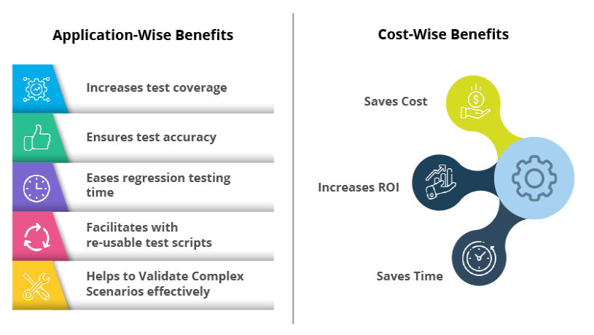
AUTOMATION TESTING
--What is Automated Software Testing?
Automated software testing is the ability to have a software tool or suite of software tools test your applications directly without human intervention. Generally test automation involves the testing tool send data to the application being tested and then compare the results with those that were expected when the test was created.

Slide 5
Motivation
Every software development group tests its products, yet delivered software always has defects. Test engineers strive to catch them before the product is released. Test Automation software is the best way to increase the effectiveness, efficiency and coverage of your software testing.

Slide 6
Abstract
This article presents a comprehensive study of test automation tools and frameworks in three main category --
A) AUTOMATION TOOLS CATEGORIES
B) TEST AUTOMATION FRAMEWORK
C) AUTOMATION TOOLS

Slide 7
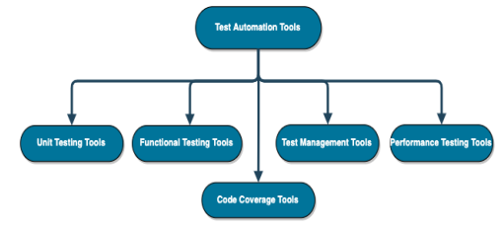
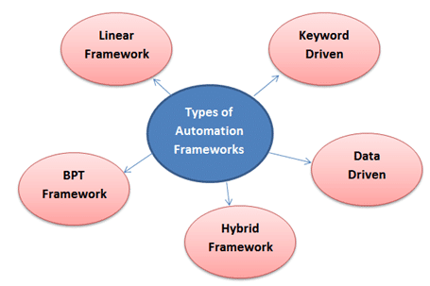
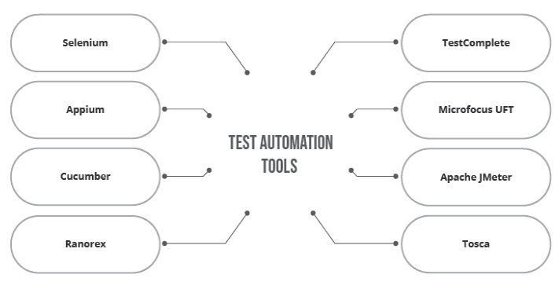
Figure no. 1
Figure no. 2
Figure no. 3

Slide 8
Output
Improves accuracy and quick finding of bugs compared to manual testing
Saves time and effort by making testing more efficient
Increases test coverage because multiple testing tools can be used at once allowing for parallel testing of different test scenarios
Automation test script is repeatable

Slide 9
Security testing
With the rise of cloud-based testing platforms and cyber attacks, there is a growing concern and need for the security of data being used and stored in software.
There are multiple types of this testing method--
Integrity
Confidentiality
Authentication
Authorization
Availability
Non-repudiation

Slide 10
Motivation
In today's world, privacy and security have been assigned foremost importance, therefore it is highly recommended to look forward for data and operations‟ security in software applications, which demands urgent attention but it is rather ignored.
Therefore, our objective is to introduce developers with an esteemed importance of system's security, which can be induced by implementing security testing methodology in SDLC process to produce a secure software system.

Slide 11
Abstract
In this paper, we are going to discus
--The contributions of academia in the field of security testing for software applications and communication systems. --Existing testing methods have been extensively reviewed and analyzed to analyze their effectiveness and applicability in different situations.
--Then, we discuss various techniques used for conducting various security assessments

Slide 12
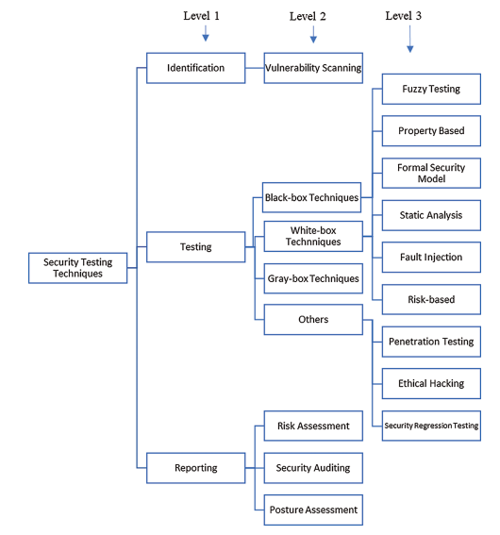
Figure no 4: Taxonomy of security testing techniques at three levels (1, 2, 3)

Slide 13
Output
Identify the threats in the system.
Measure the potential vulnerabilities of the system.
Help in detecting every possible security risks in the system.
Help developers in fixing the security problems through coding.

Slide 14
Load testing
--What is Load testing?
Load testing is the process of putting increasing amounts of simulated demand on your software, application, or website to verify whether or not it can handle what it’s designed to handle.

Slide 15
Motivation
Some extremely popular sites have suffered serious downtimes when they get massive traffic volumes. E-commerce websites invest heavily in advertising campaigns, but not in Load Testing to ensure optimal system performance, when that marketing brings in traffic. So the load testing is being most important step before delivering software to provide minimum barrier services.

Slide 16
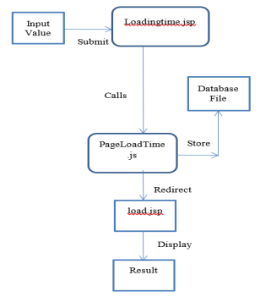
Abstract
--Through this paper, to analyze the load the website can carry up to which extent, the stress is made on the application part. The application is laid in a great deal of regularity frequently to shattering juncture such as the steadiness of the website maybe possibly deemed. To use the results in future for further studies by the developer or the tester they are stored in a database.
Fig 5: Illustration of Load Testing

Slide 17
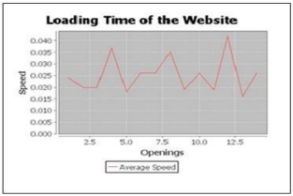
Output
Response time for each transaction
Performance of System components under various loads
Performance of Database components under different loads
Network delay between the client and the server
Software design issues
Server configuration issues like a Web server, application server, database server etc.
Hardware limitation issues like CPU maximization, memory limitations, network bottleneck, etc.
Fig 6: The illustration of the Load Time.

Slide 18
Conclusion
Software testing is an important part of the software development process. It is not a single activity that takes place after code implementation, but is part of each stage of the lifecycle.
A successful test strategy will begin with consideration during requirements specification. Testing details will be fleshed through high and low level system designs, and testing will be carried out by developers and separate test groups after code implementation. As with the other activities in the software lifecycle, testing has its own unique challenges. As software systems become more and more complex, the importance of effective, well planned testing efforts will only increase.

Slide 19
Reference
1.Mubarak Albarka Umar et al. / International Journal of Computer Science Engineering (IJCSE) --A Study of Automated Software Testing: Automation Tools and Frameworks.
2. Intelligent Automation & Soft Computing DOI:10.32604/iasc.2021.017260-Analysis of Security Testing Techniques.
3. International Journal of Innovative Research in Computer Science & Technology (IJIRCST) ISSN: 2347-5552, Volume-8, Issue-3, May 2020 https://doi.org/10.21276/ijircst.2020.8.3.25 www.ijircst.org - Load Testing Analyzer for Web Application

